Slide 1
Convolutional Neural Networks (CNNs)
Deep Learning for Image and Signal Processing
Notes:
Introduce the concept of CNNs, their importance in deep learning, and the agenda for the presentation.

Slide 2
Convolution Operation
A kernel (filter) slides over the input computing weighted sums
Same weights are reused across the spatial dimension, reducing parameters
Stride and padding control output size and receptive field
Notes:
Explain the convolution operation, its purpose, and how it's used in CNNs. Provide examples of convolutional layers and their applications.

Slide 3
Pooling Layers
Pooling downsamples feature maps to reduce spatial size and computation
Max pooling keeps the most activated value within a window
It provides translation invariance and reduces overfitting
Notes:
Discuss the role of pooling layers in CNNs, including max pooling and average pooling. Explain how pooling helps reduce spatial dimensions and retain important features.

Slide 4
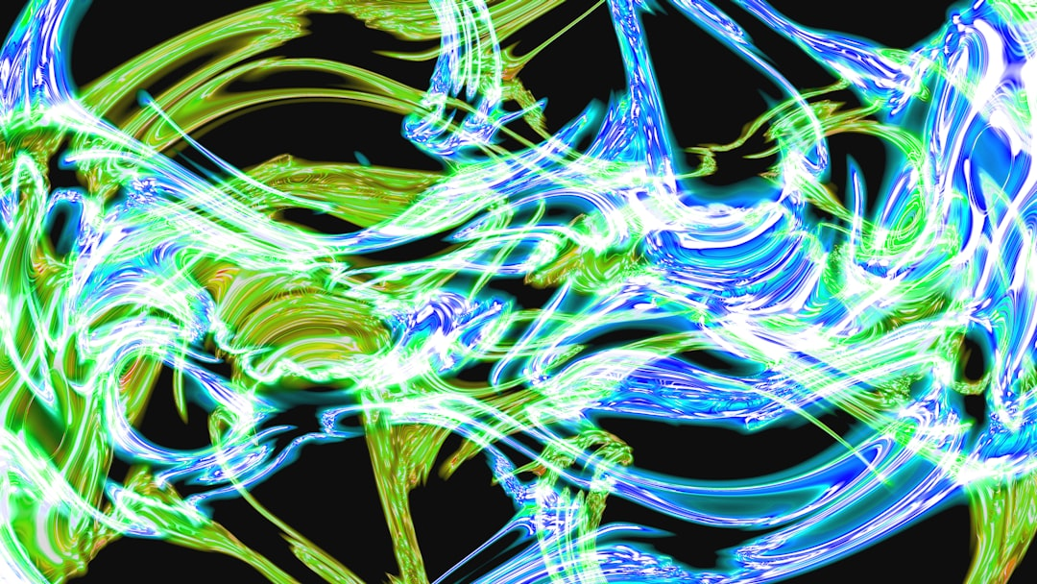
CNN Architecture Example
Typical CNN: Conv → ReLU → Pool blocks followed by fully connected layers
Deeper architectures like VGG, ResNet stack many such blocks
Output layer uses softmax for multi-class classification
Notes:
Present a simple CNN architecture example, explaining each layer's function and how they work together. Use visual aids to illustrate the architecture.

Slide 5
Applications of CNNs
Image classification, object detection, segmentation and face recognition
Medical image analysis and autonomous driving perception
Document understanding and scene text recognition
Notes:
Explore various applications of CNNs, including image classification, object detection, and image segmentation. Discuss the advantages and limitations of using CNNs in these applications.

Slide 6
Convolutional Neural Network Basics
CNNs are a type of deep learning model
Inspired by the structure of the human brain
Use convolutional and pooling layers
Apply to image and signal processing tasks
Can learn features from raw data
Require large amounts of training data
Can be computationally intensive
Have many applications in computer vision
Can be used for image classification and object detection
Notes:
Explain the basics of CNNs, including their inspiration, architecture, and applications. Discuss the importance of large datasets and computational resources. Ask students to think of potential applications and limitations.

Slide 7
Key CNN Architectures
LeNet-5: early CNN architecture
AlexNet: large-scale CNN architecture
VGGNet: deep CNN architecture
ResNet: residual learning CNN architecture
Inception: multi-scale CNN architecture
Use pre-trained models for transfer learning
Fine-tune pre-trained models for specific tasks
Regularly update models to adapt to new data
Monitor model performance on validation sets
Notes:
Discuss key CNN architectures, including their strengths and weaknesses. Explain the concept of transfer learning and fine-tuning pre-trained models. Ask students to consider the importance of model updating and validation.

Slide 8
CNN Training and Optimization
Stochastic gradient descent (SGD) optimizer
Adam optimizer: adaptive learning rate
Batch normalization: normalize layer inputs
Dropout: prevent overfitting
Regularization techniques: L1 and L2
Early stopping: prevent overfitting
Learning rate scheduling: adapt to training progress
Monitor training and validation loss
Visualize model performance on test sets
Notes:
Explain the importance of training and optimization in CNNs. Discuss various optimization techniques, including SGD, Adam, and batch normalization. Ask students to consider the role of regularization and early stopping in preventing overfitting.

Slide 9
CNN Applications in Computer Vision
Image classification: classify images into categories
Object detection: detect objects within images
Image segmentation: segment images into regions
Image generation: generate new images
Image-to-image translation: translate images between domains
Facial recognition: recognize individuals from facial images
Autonomous vehicles: detect and respond to surroundings
Medical imaging: analyze medical images for diagnosis
Surveillance: monitor and analyze video feeds
Notes:
Explore various applications of CNNs in computer vision, including image classification, object detection, and image segmentation. Discuss the potential impact of these applications on society and industry. Ask students to think of potential future applications and challenges.

Slide 10
Summary of Convolutional Neural Networks
A kernel (filter) slides over the input computing weighted sums
Pooling downsamples feature maps to reduce spatial size and computation
Typical CNN: Conv → ReLU → Pool blocks followed by fully connected layers
Image classification, object detection, segmentation and face recognition
CNNs are a type of deep learning model
Notes:
Summarize the key takeaways from the presentation, including the basics of CNNs, their applications, and the importance of training and optimization. Ask students to reflect on what they've learned and how they can apply it in their own projects. Provide resources for further learning and exploration.

